Slide 1


Slide 2

INTRODUCTION
High Cloud Airlines operates as a regional carrier with a primary focus on serving routes within the United States, especially connecting smaller cities and remote areas. The dataset captures detailed operational and logistical information that reflects the airline's commitment to regional connectivity.
Diverse Operations
Operational Insights
Geographical Reach
Aircraft Service

Slide 3
OBJECTIVE
1
OPTIMIZE OPERATIONS
2
ENABLE CUSTOMER EXPERIENCE
3
ROUTE ANALYSIS
4
DRIVE REVENUE GROWTH

Slide 4
Dataset overview
Flight schedules, departures, and load factors.
Passenger, freight, and mail transport data.
Route details with origin and destination info.
Aircraft configurations and service classes.
Time-based attributes for trend analysis.

Slide 5
METHODOLOGY
Tools Used:
Excel for data cleaning, SQL for querying, and Tableau/Power BI for visualization.
Data Cleaning:
Handled missing values and standardized formats in Excel.
EDA:
Conducted trend and metric analysis using Excel, Power BI, and Tableau.
Visualizations:
Created interactive dashboards and charts in Tableau and Power BI to highlight key insights.
SQL
POWERBI

Slide 6
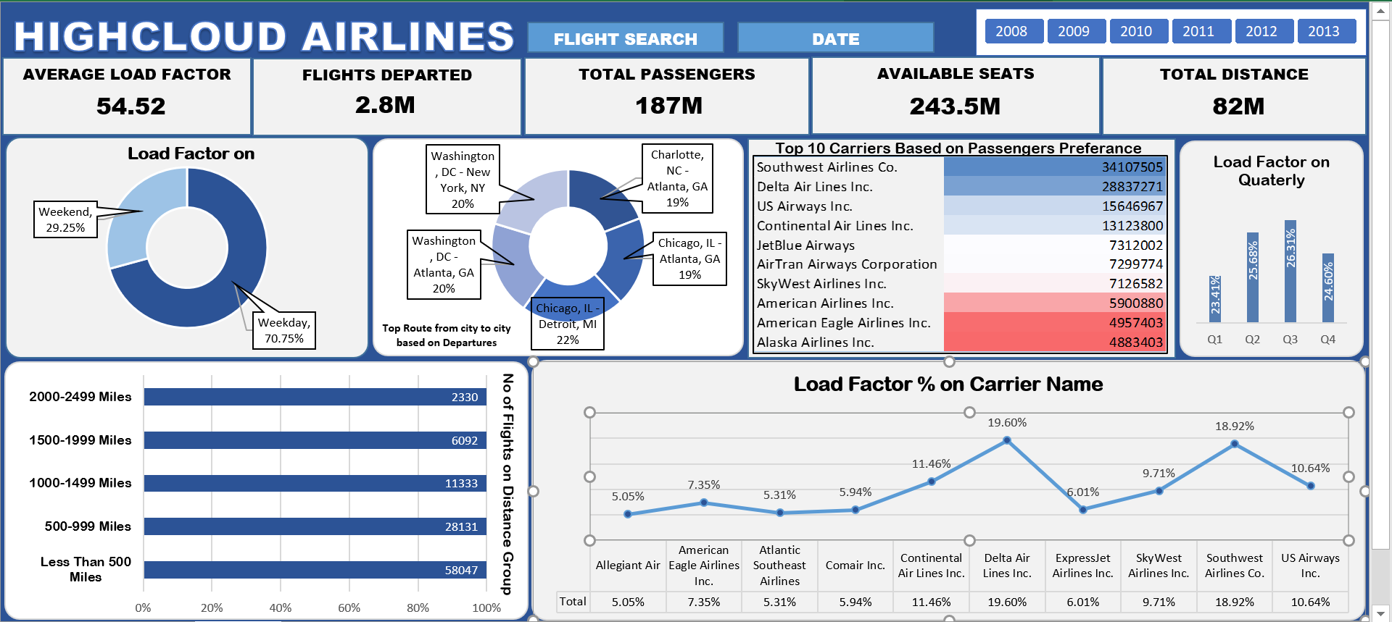

Slide 7
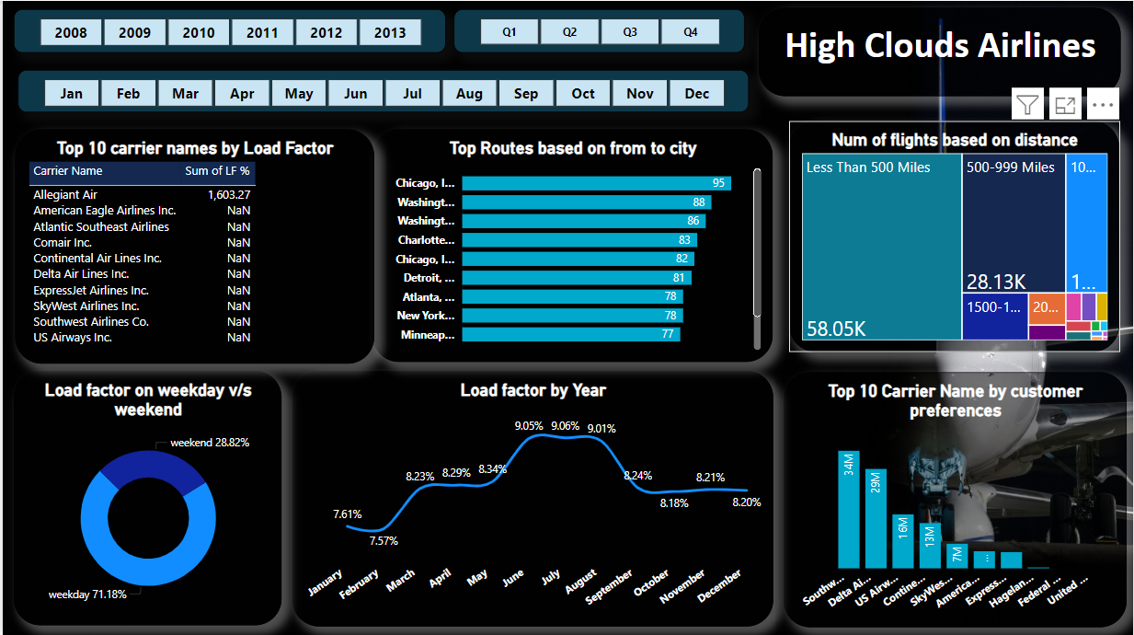

Slide 8
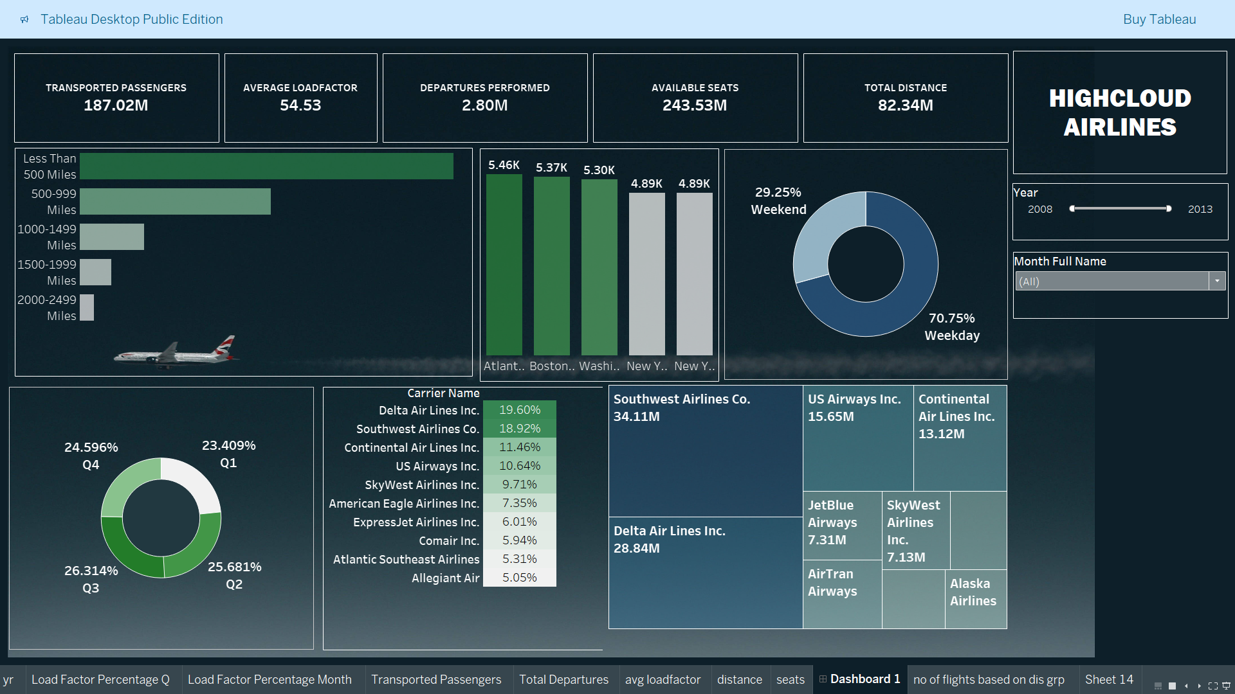

Slide 9
WHAT WE FOUND
1.) Average Load Factor (54.52):
Indicates seat utilization efficiency.
2.) Flights Departed (2.8M):
Total flights successfully operated.
3.) Total Passengers (187M): Passengers carried by the airline.
4.) Available Seats (243.5M):
Total seating capacity offered.
5.) Total Distance (82M):
Total distance flown by all flights

Slide 10
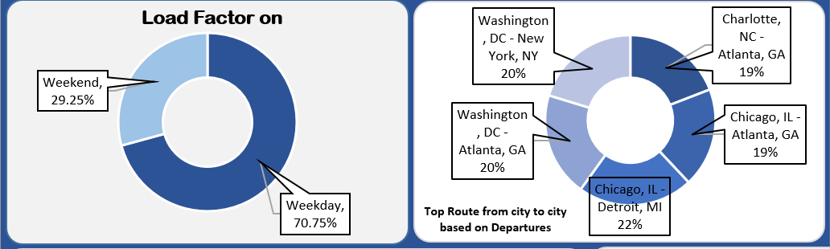
Load Factor on Weekdays vs. Weekends:
Weekdays account for 70.75% of the load factor, significantly higher than weekends (29.25%).
Suggests more passenger traffic and operational efficiency during weekdays.

Slide 11
Top City-to-City Routes by Departures:
The busiest routes are Chicago, IL - Detroit, MI (22%), followed by Washington, DC - New York, NY (20%) and Charlotte, NC - Atlanta, GA (19%).
Highlights key markets and demand hubs for the airline.

Slide 12
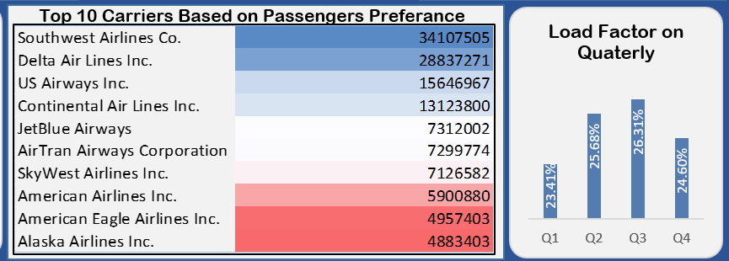
Top 10 Carriers Based on Passenger Preference:
Southwest Airlines leads with the highest passenger preference (34.1M), followed by Delta Air Lines (28.3M) and US Airways (15.6M).
Reflects customer loyalty and operational success among carriers.

Slide 13
Load Factor on Quarterly Basis:
Load factor peaks in Q2 (25.68%) and Q3 (26.31%), indicating higher demand during mid-year, while Q1 (23.41%) and Q4 (24.60%) show relatively lower activity.
Suggests seasonal variations in travel patterns.

Slide 14
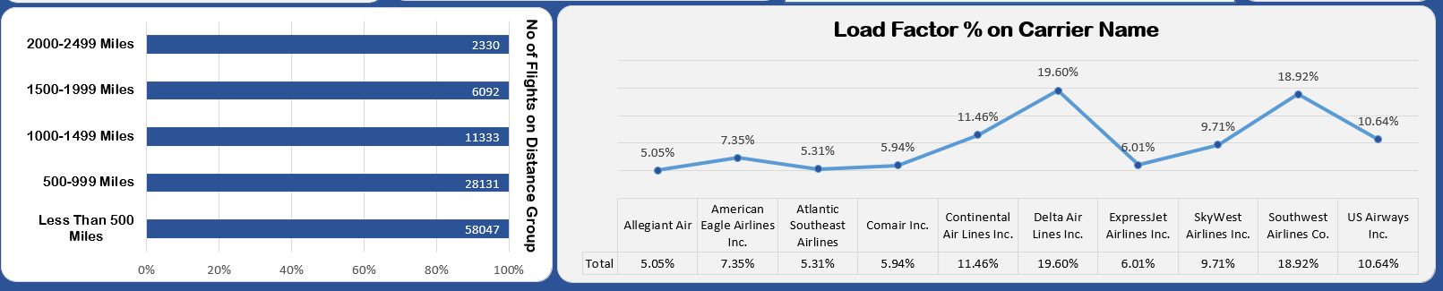
Number of Flights by Distance Group:
Majority of flights (58,047) cover short distances under 500 miles, indicating a focus on regional connectivity.
Flights in the 500–999 mile range are the second most frequent (28,131), showcasing a preference for medium-haul routes.
Long-distance flights (1,000+ miles) have significantly fewer departures, with only 11,333 for 1,000–1,499 miles and just 2,330 for 2,000–2,499 miles, reflecting limited long-haul operations

Slide 15
Load Factor on Carrier Name:
Delta Air Lines leads with the highest load factor at 19.60%, showcasing strong passenger demand and efficient seat utilization.
Southwest Airlines and SkyWest Airlines follow with load factors of 18.92% and 9.71%, respectively, indicating solid performance in their market segments.
Other carriers, such as Continental Air Lines (11.46%) and US Airways (10.64%), show moderate load factors, while smaller airlines like Allegiant Air (5.05%) have lower utilization.

Slide 16
RECOMMENDATION
Improve Weekend Load Factors
Implement promotional campaigns or discounts to increase passenger demand on weekends.
Enhance Passenger Experience
Invest in onboard amenities and improved customer service to attract repeated customers

Slide 17
RECOMMENDATION
Seasonal Price Strategies
Offer Discount during off season (Q1 & Q4) to increase revenue
Enhance Career Partnerships
Collaborate with top-performing carriers like Southwest Airlines, AND Delta Airlines Inc. to increase market reach

Slide 18

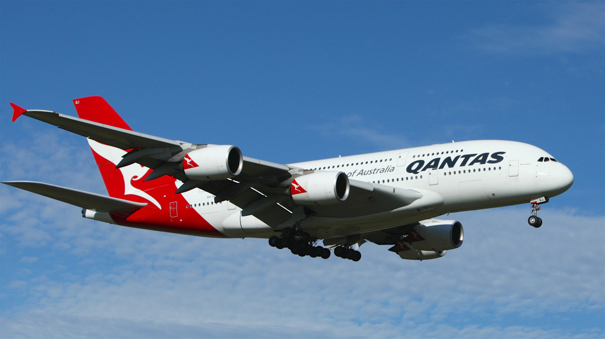
CHALLENGES
Large Dataset
Handling and analyzing a vast amount of data was time – consuming and required tool optimization
Complex Relationships
Identifying meaningful insights from multiple interconnected metrics was challenging

Slide 19
CONCLUSION
The analysis highlights key operational metrics, passenger trends, and route performance for High Cloud Airlines.
By focusing on high-demand routes, optimizing underutilized flights, and enhancing weekend and seasonal strategies, the airline can improve efficiency and revenue. Implementing these insights will drive better resource allocation, improve customer satisfaction, and ensure sustainable growth.

Slide 20
Thank You

